Slide 1
Lent Week 3

Slide 2
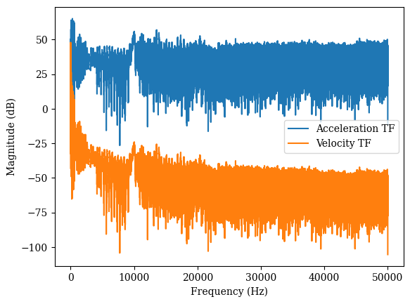
Beam Data
Quite sensitive to magnitude, when dividing by 2pi performance is worse (lower magnitude peaks ?)
No predictions at high frequencies
Need to remove first datapoint (divide by 0 issues causes model to fail)
Raw data:

Slide 3
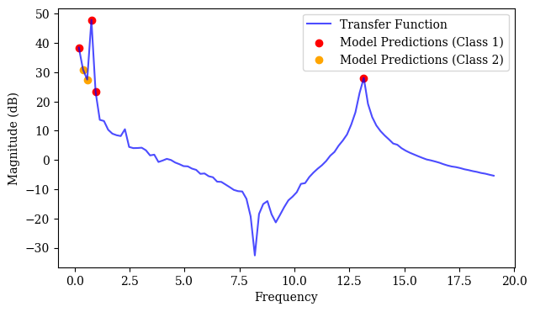
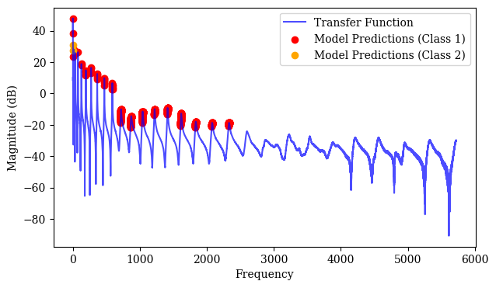
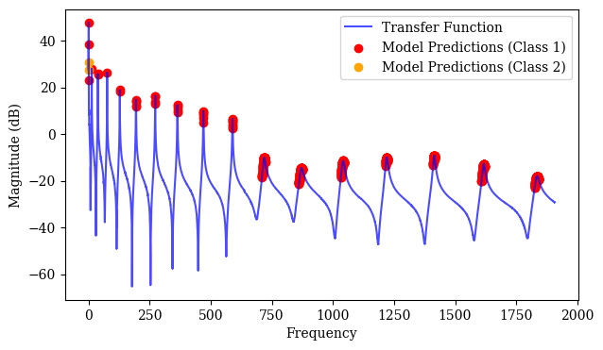
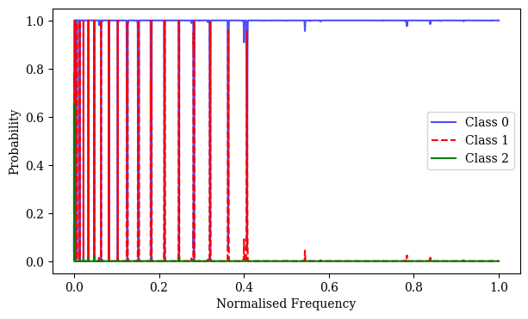
Beam Data (no dividing by 2pi – though this is wrong I think)

Slide 4
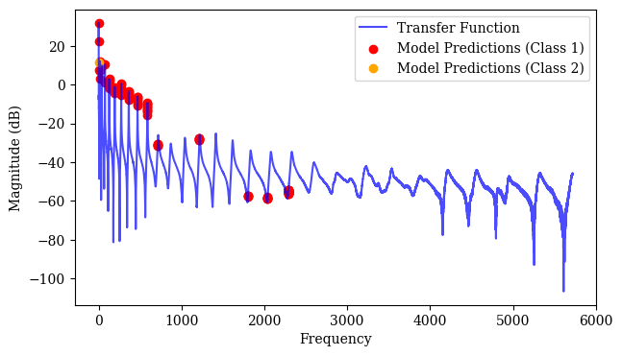
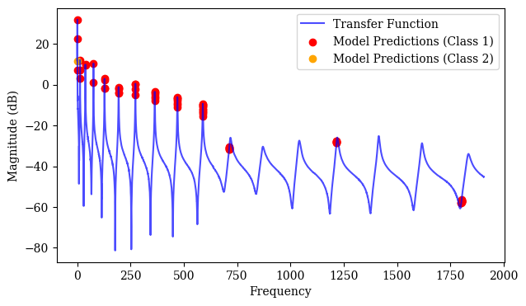
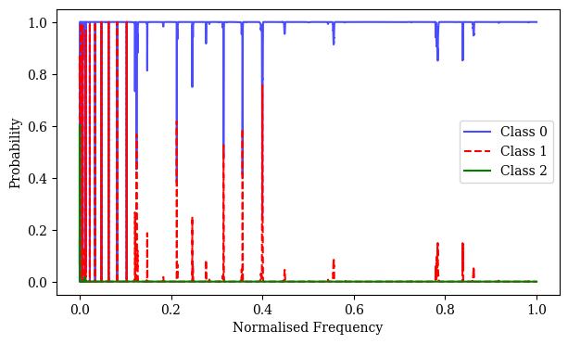
Beam Data (dividing by 2pi – think this is correct)
Stops working at earlier frequency (around 600Hz compared to around 2400Hz)
Also making some odd predictions

Slide 5
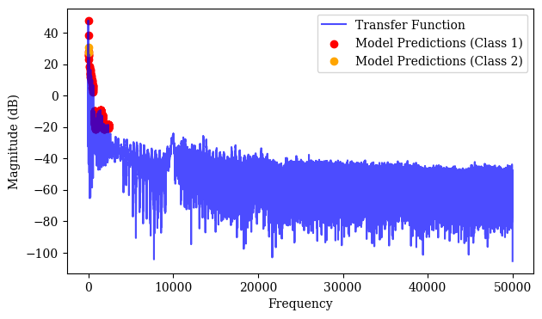
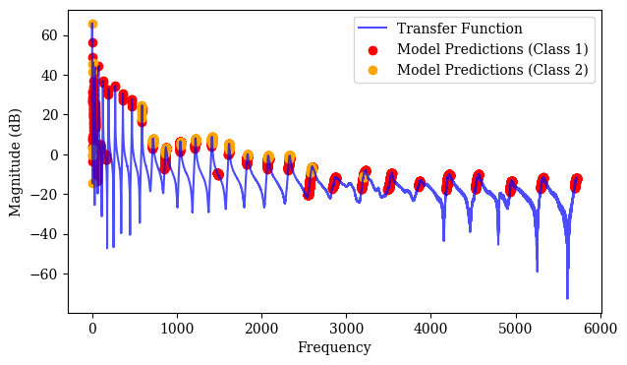
Too sensitive to magnitude, more modes now predicted when raw data multiplied by 10 – not good (not generalising well)
Predictions only at low frequencies (in both cases)

Slide 6
Training new model
Normalise magnitude, real part and imaginary part by 95% of max magnitude
Didn’t work first time – overpredicting far too much
Needed to modify weights in loss function, also increased training data size to 32,000

Slide 7
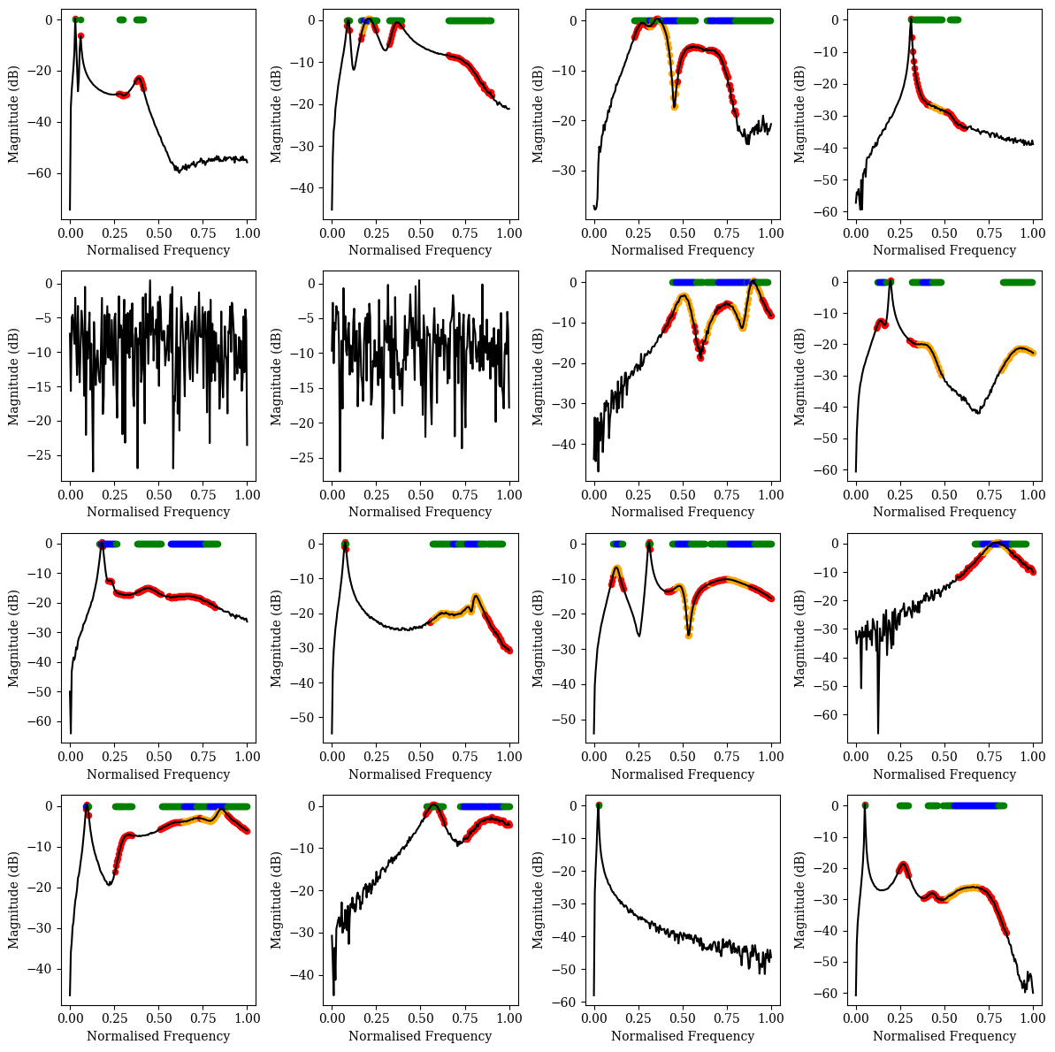
Predictions
Overpredicting class 2, need to reduce weight and retrain (to do …)

Slide 8
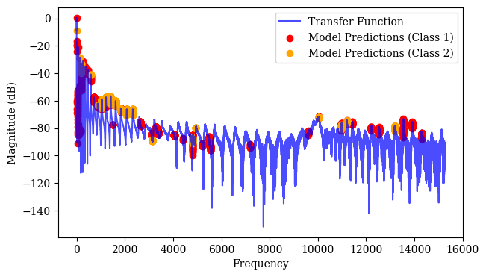
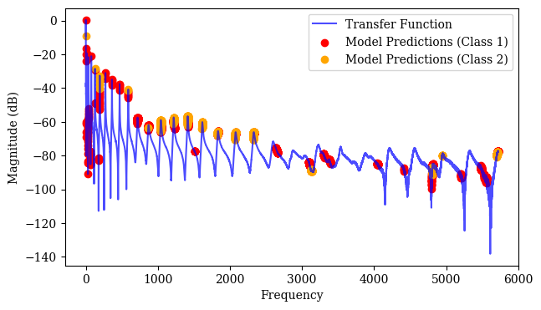
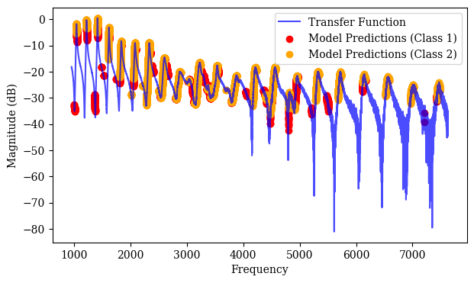
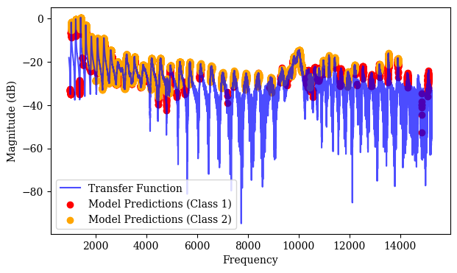
Beam Data
Due to normalisation, predictions now depend on which part of the input is passed to the model !
Better predictions but restricted freq range (and also overpredicting class 2)

Slide 9
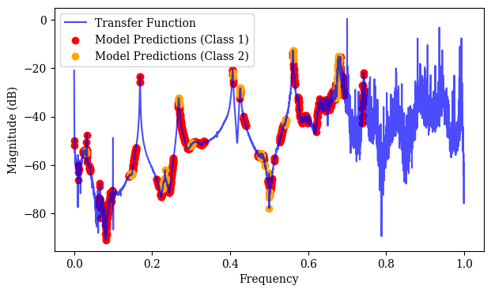
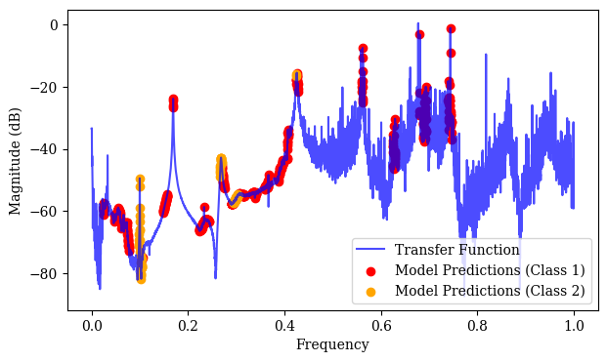
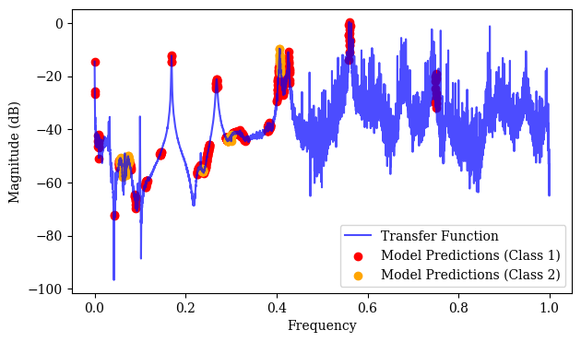
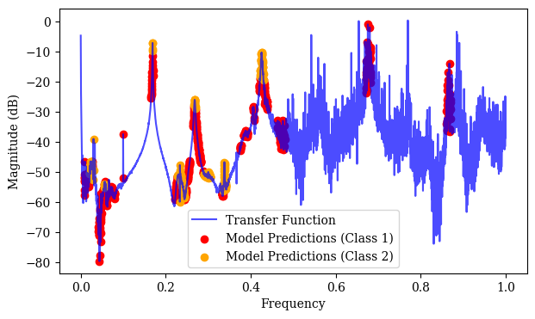
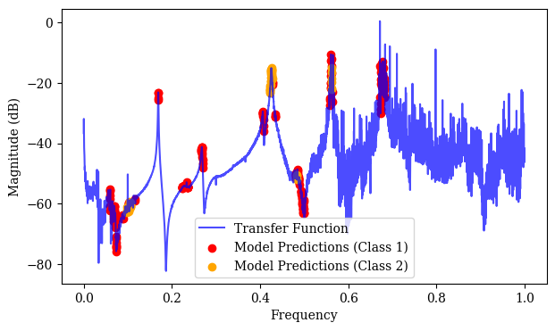
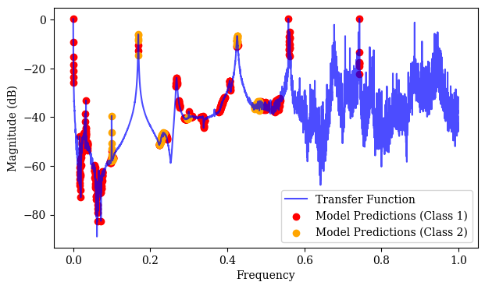
4C6 (first 6 channels) – converted to velocity TF

Slide 10
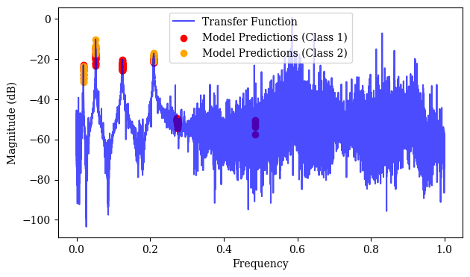
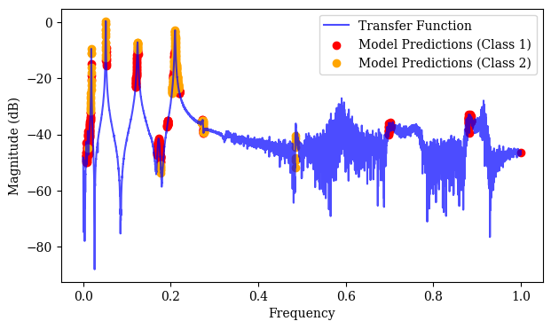
3C6
Overpredicting a fair bit on data without noise, has located all features though

Slide 11
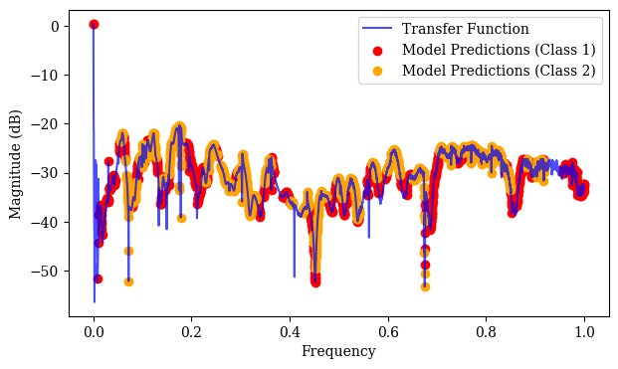
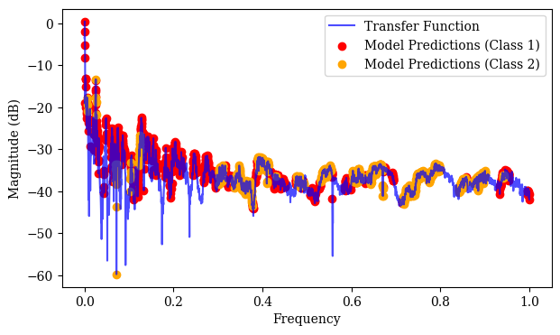
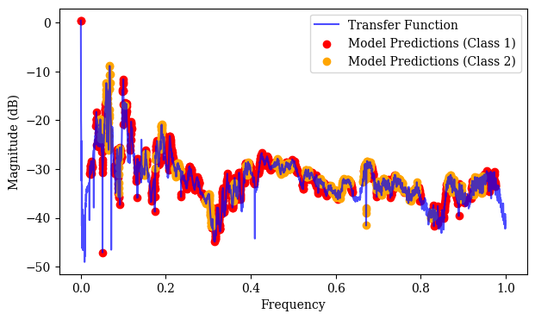
Clavichord/ spinet/ harpsichord

Slide 12
Next
Try to improve weights in model (reduce class 2) and retrain
Move on to Bayesian inference, need to get priors

